Slide 1

Presentation Topic : Emotion Recognition using K-Means
Subject: Data Mining Lab
PRESENTED BY
SHUVOBROTO BISWAS
ID: 183002066
Shishir Chandra Dash
ID: 203002071
Department of CSE
PRESENTED TO
Md. Gulzar Hussain
Lecturer
Department of CSE

Slide 2
Contents
Definations
Explaination
Concluation

Slide 3
Defination
K-Means Clustering is an unsupervised learning algorithm that is used to solve the clustering problems in machine learning or data science. In this topic, we will learn what is K-means clustering algorithm, how the algorithm works, along with the Python implementation of k-means clustering.

Slide 4
Explaination
K-Means Clustering is an Unsupervised Learning algorithm, which groups the unlabelled dataset into different clusters. Here K defines the number of pre-defined clusters that need to be created in the process, as if K=2, there will be two clusters, and for K=3, there will be three clusters, and so on.

Slide 5
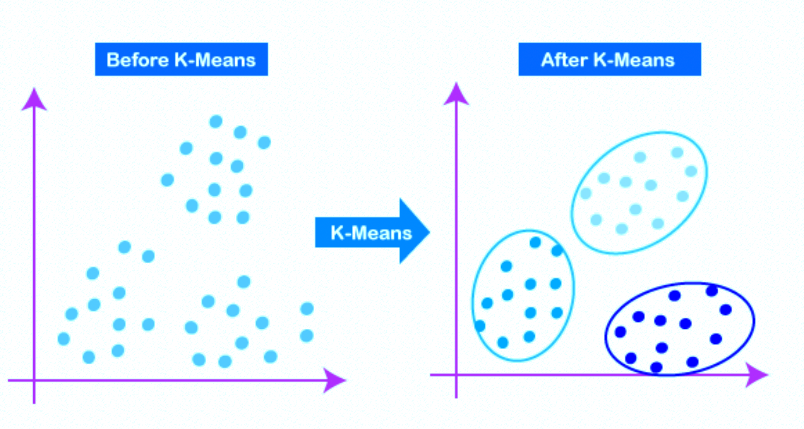
Explaination

Slide 6
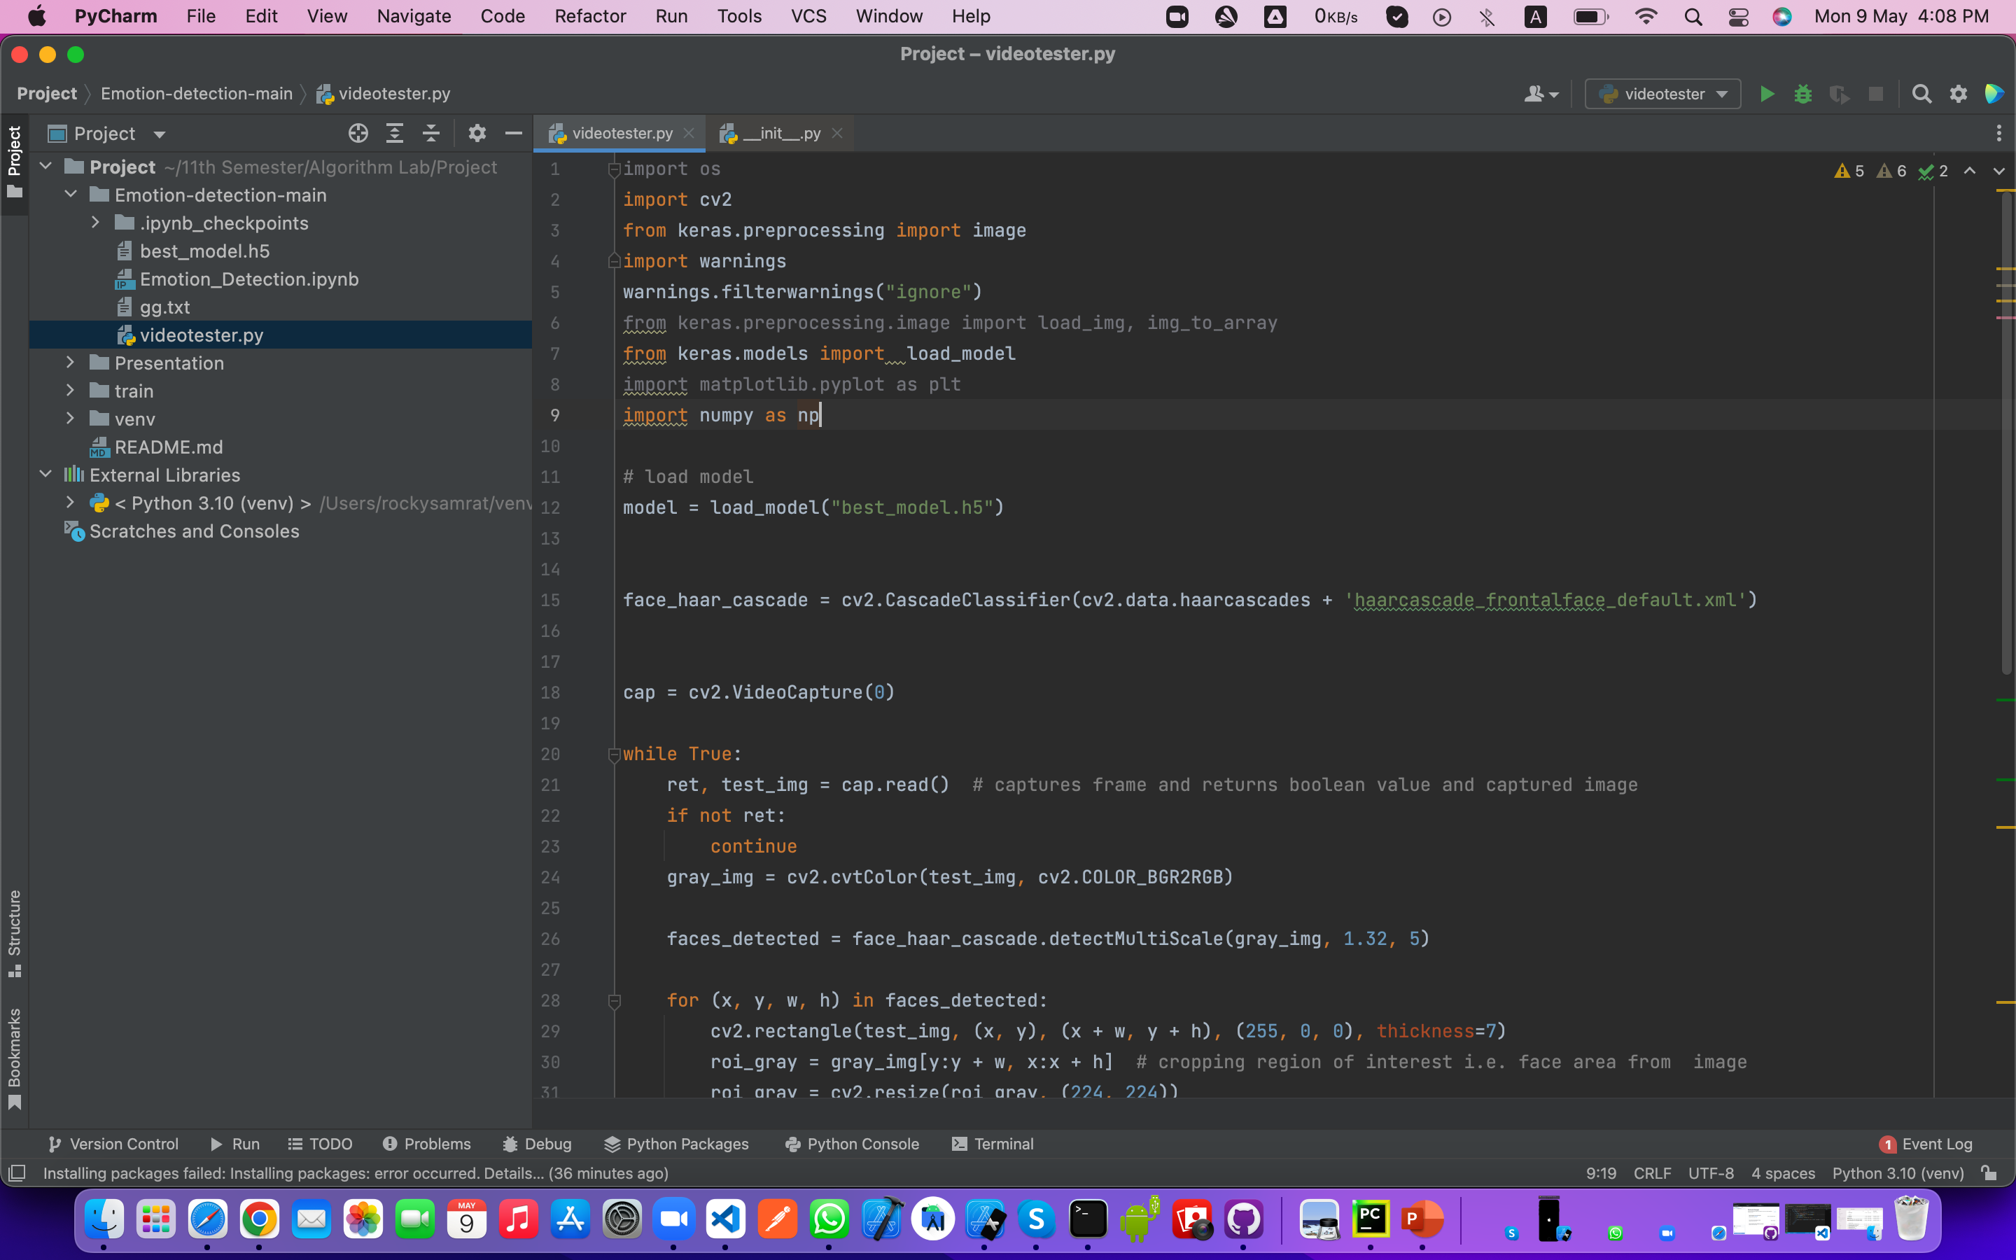
Explaination

Slide 7
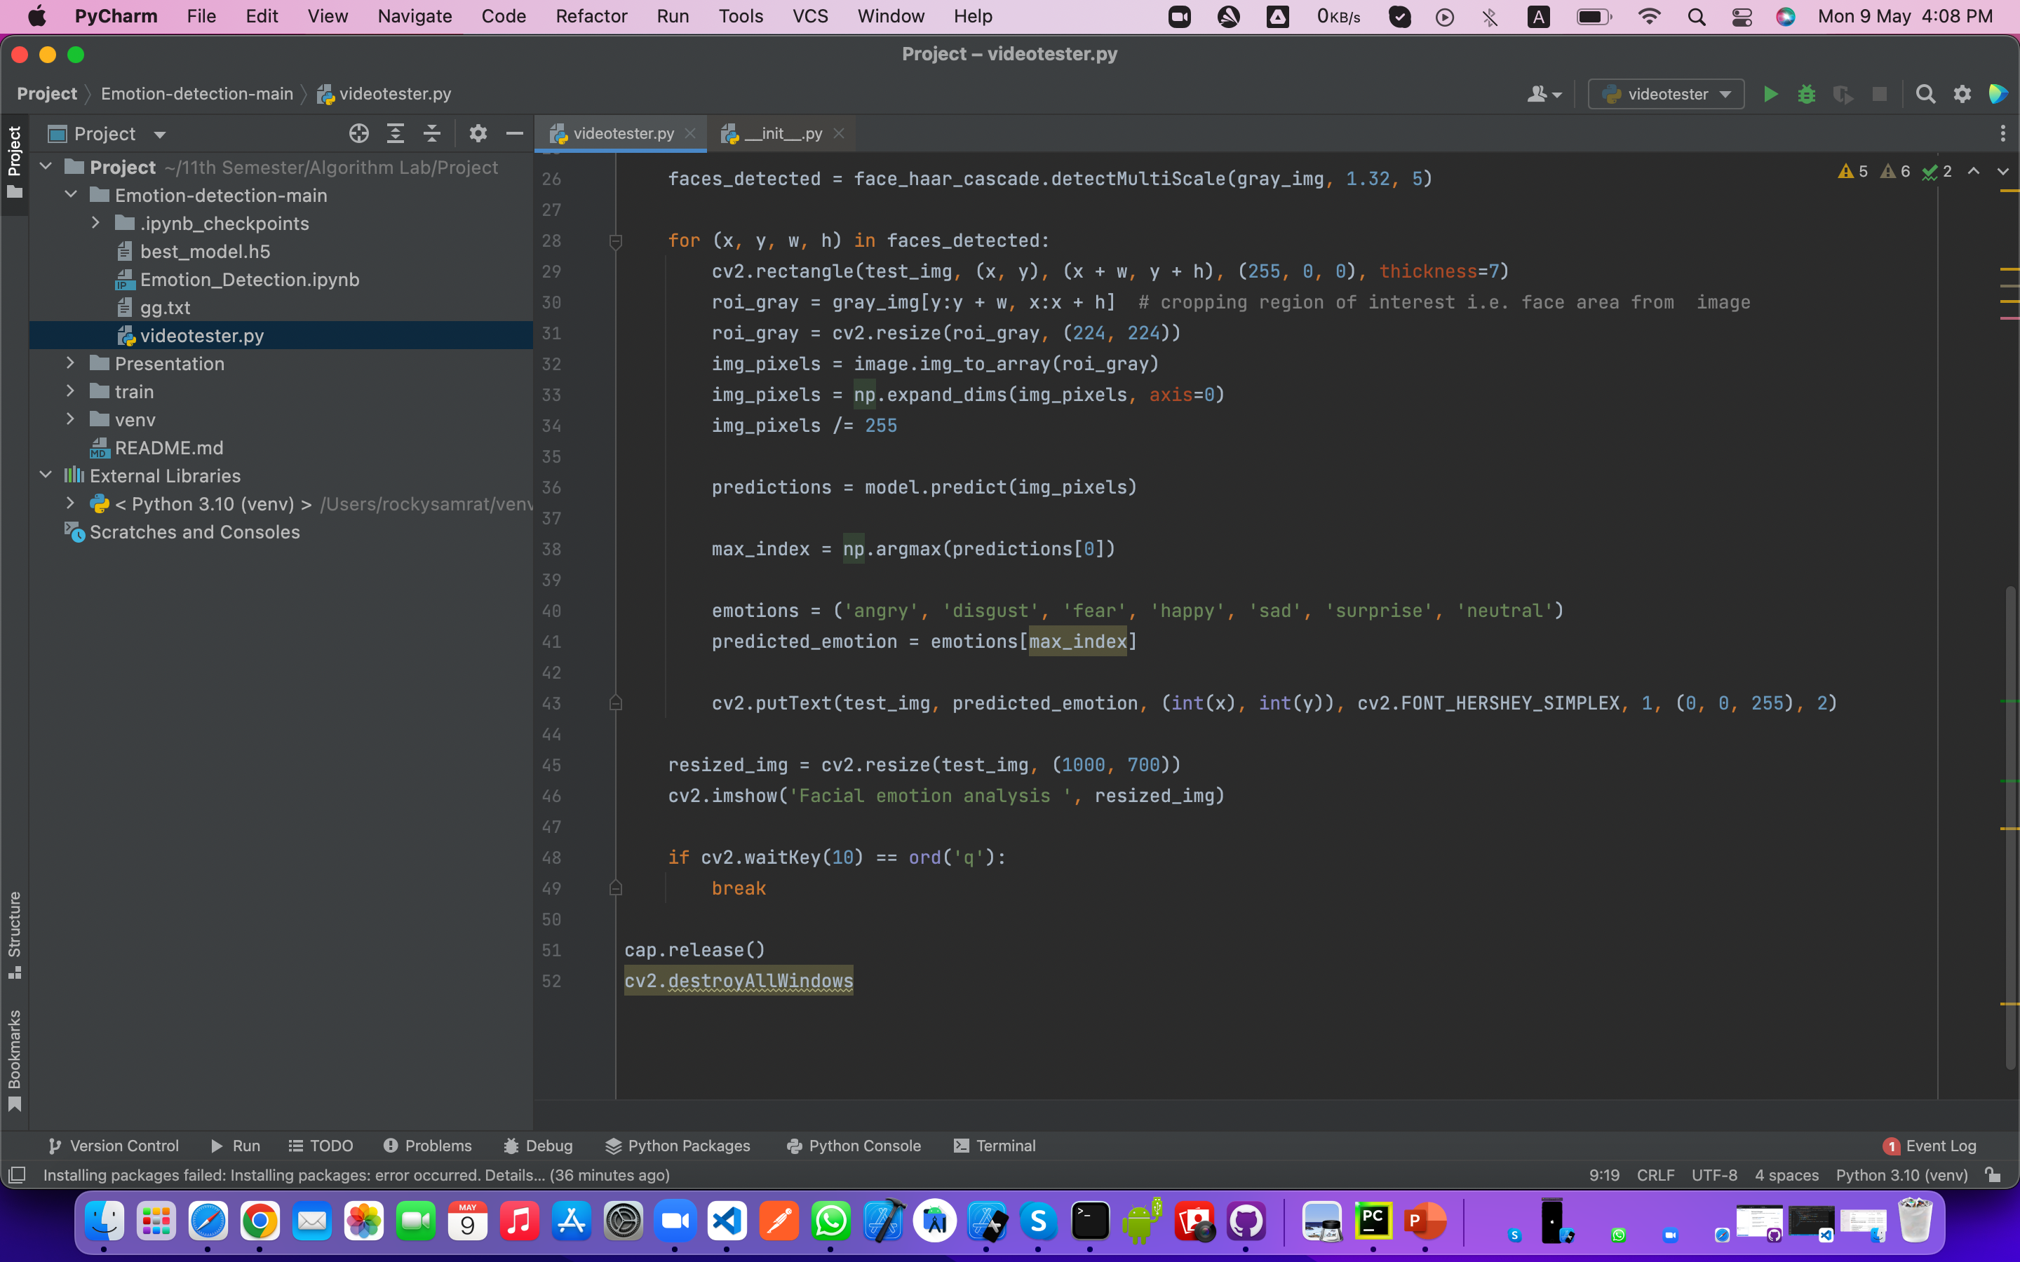
Explaination

Slide 8
Concluation
The performance of the K-means clustering algorithm depends upon highly efficient clusters that it forms. But choosing the optimal number of clusters is a big task. There are some different ways to find the optimal number of clusters, but here we are discussing the most appropriate method to find the number of clusters or value of K and that we applied on our emotion systems.

Slide 9
Thank you

